Slide 1
Simpson’s Paradox
Visualized
Data taken from
Charig CR, Webb DR, Payne SR, Wickham JE. Comparison of treatment of renal calculi by open surgery, percutaneous nephrolithotomy, and extracorporeal shockwave lithotripsy. British Medical Journal (Clinical research ed). 1986;292(6524):879-882.
Visualization inspired by John Burn-Murdoch / @jburnmurdoch

Slide 2
Simpson’s Paradox
Case study:
A real-life medical study comparing success rates of two treatments for kidney stones.
Treatment A: open surgery
Treatment B: less-invasive procedure
Data from Charig et. al. 86’

Slide 3
Simpson’s Paradox
Treatment | A | B
 | 273/350 = 78.0% | 289/350 = 82.5%
Equal group sizes. Treatment B is better.
Notes:
Equal group size: 350.
Treatment B is better…

Slide 4
Simpson’s Paradox
Treatment Stone size | A | B
Both sizes | 273/350 = 78.0% | 289/350 = 82.5%
Small | 93.1% | 86.67%
Large | 73.0% | 68.75%
How come Treatment A is better in both small and large stones, but worse overall?
Notes:
… or is it?

Slide 5
Simpson’s Paradox
Treatment Stone size | A | B
Both sizes | 273/350 = 78.0% | 289/350 = 82.5%
Small | 81/87 = 93.1% | 234/270 = 86.67%
Large | 192/263 = 73.0% | 55/80 = 68.75%
Unequal distribution of severe/easy cases across treatments.
Notes:
Unequal distribution of good/bad cases among treatment.
Fractions don’t always comply to our intuition: A/B>a/b and C/D>c/d does not follow (A+C)/(B+D) > (a+c)/(b+d)

Slide 6
Simpson’s Paradox
Treatment Stone size | A | B
Both sizes | 273/350 = 78.0% | 289/350 = 82.5%
Small | 81/87 = 93.1% | 234/270 = 86.67%
Large | 192/263 = 73.0% | 55/80 = 68.75%
Stone size is a confounder: it affects both the outcome (bigger stones has less chance for success) and the treatment assignment (bigger stones might not be feasible for the non-invasive treatment, open surgery might be “an overkill” for small stones) – Treatment B had unfairly more easy cases, thus the higher success rate

Slide 7
Visualizing how IPW can mitigate the confounding effect.

Slide 8
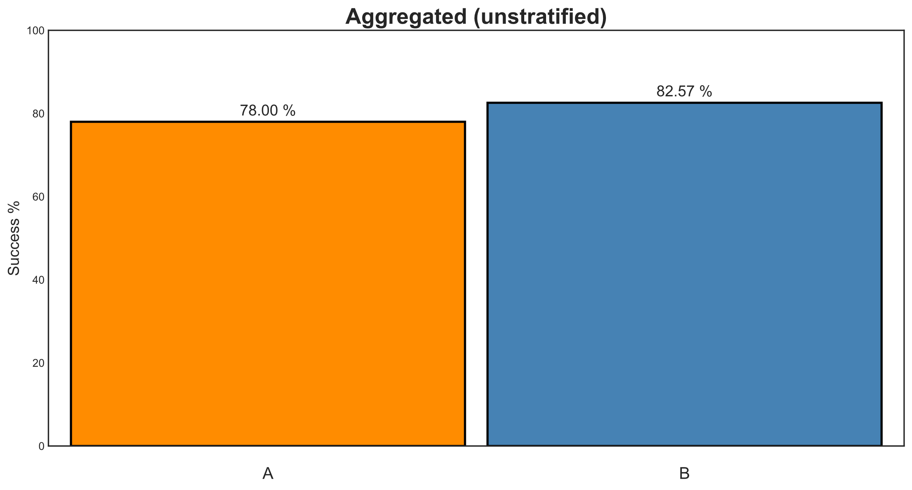

Slide 9
Width represents number of subjects

Slide 10
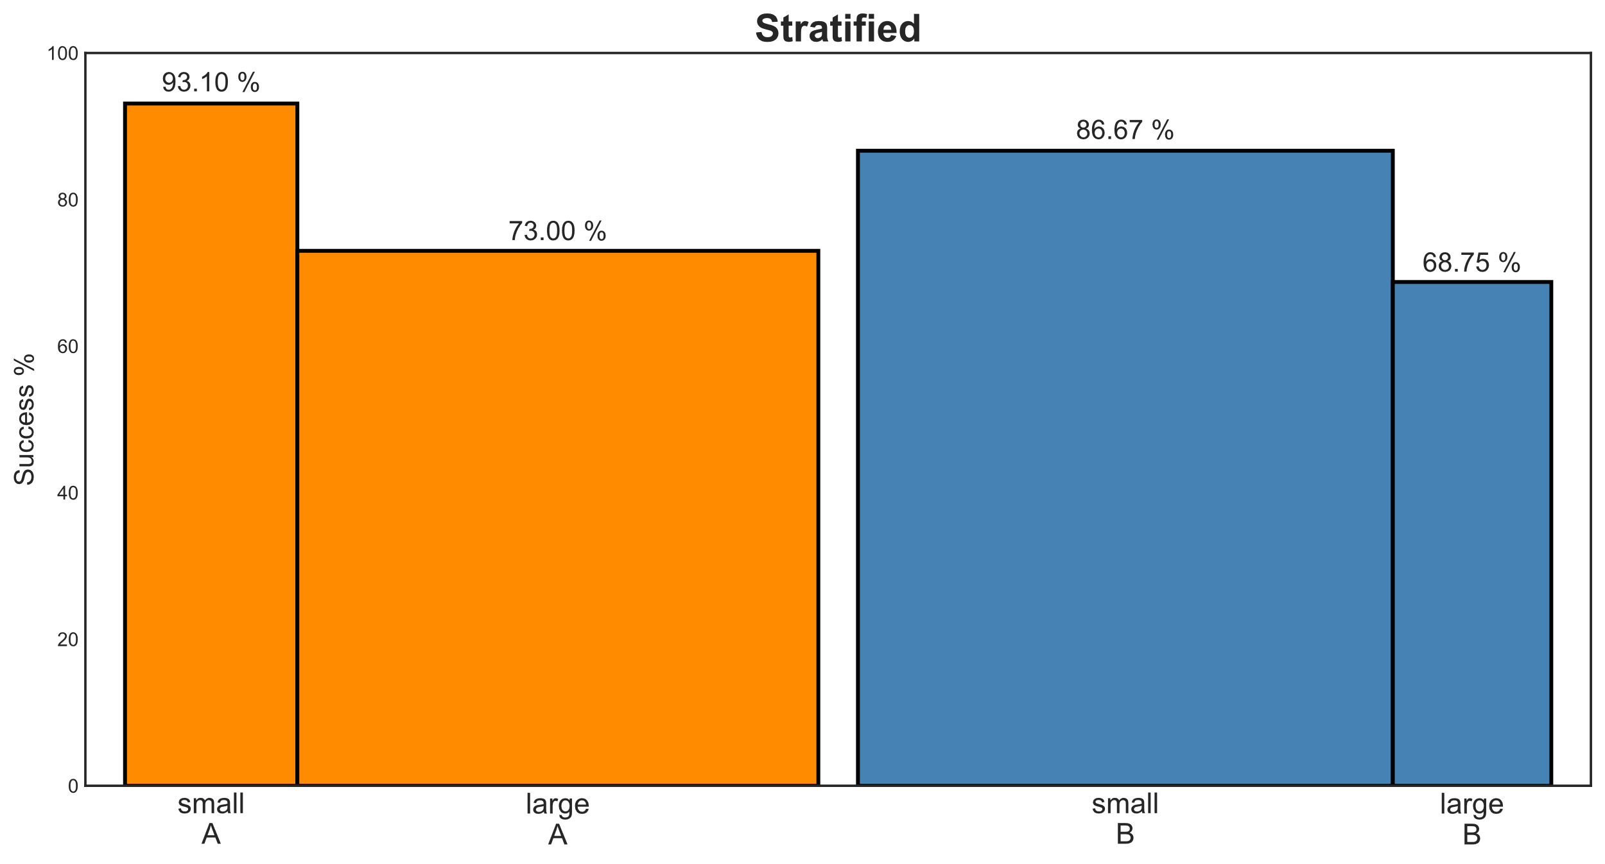

Slide 11
Place confounders next to each other

Slide 12
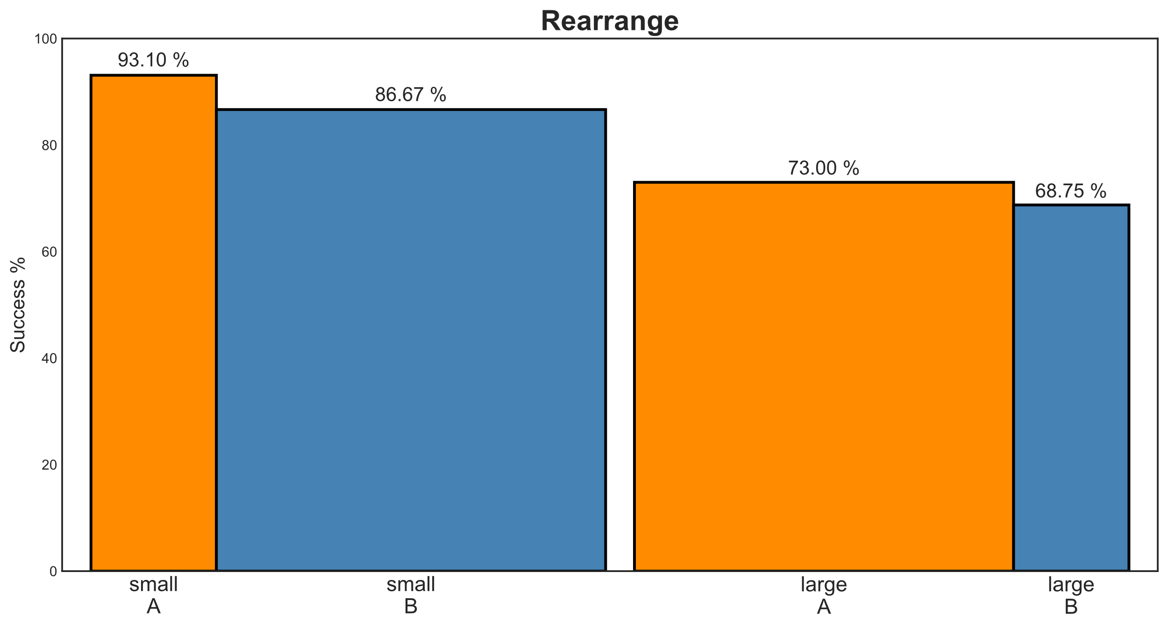

Slide 14
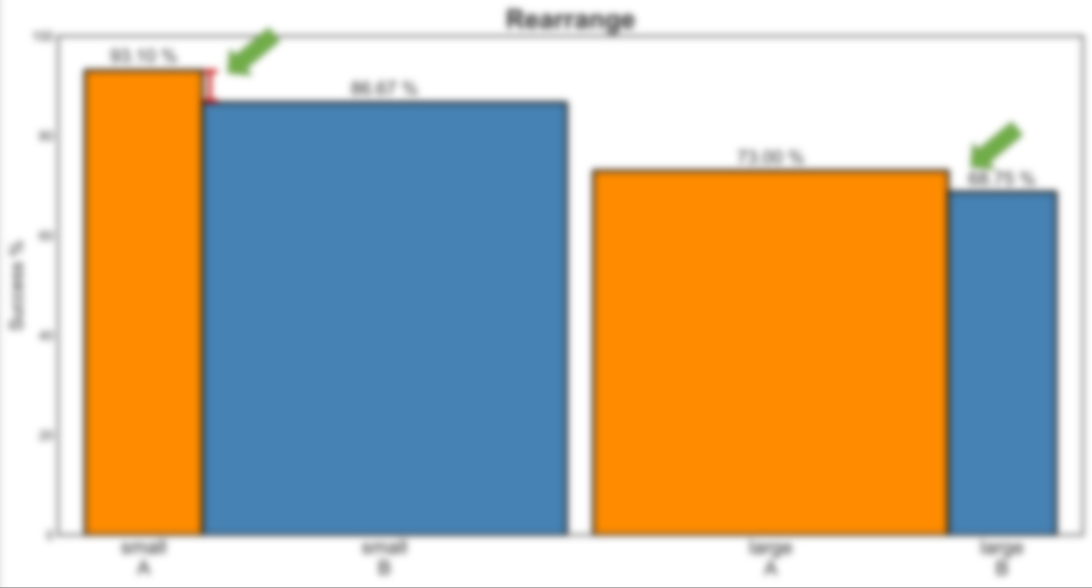
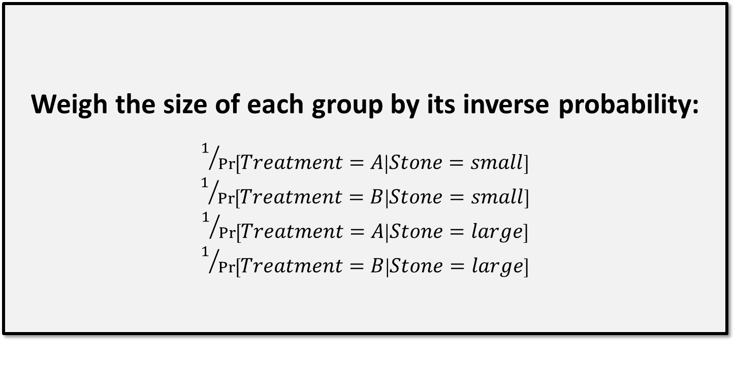
Weigh the size of each group by its inverse probability:
$1/{\operatorname{Pr}\left[Treatment=A | Stone=small\right]}$
$1/{\operatorname{Pr}\left[Treatment=B | Stone=small\right]}$
$1/{\operatorname{Pr}\left[Treatment=A | Stone=large\right]}$
$1/{\operatorname{Pr}\left[Treatment=B | Stone=large\right]}$

Slide 15
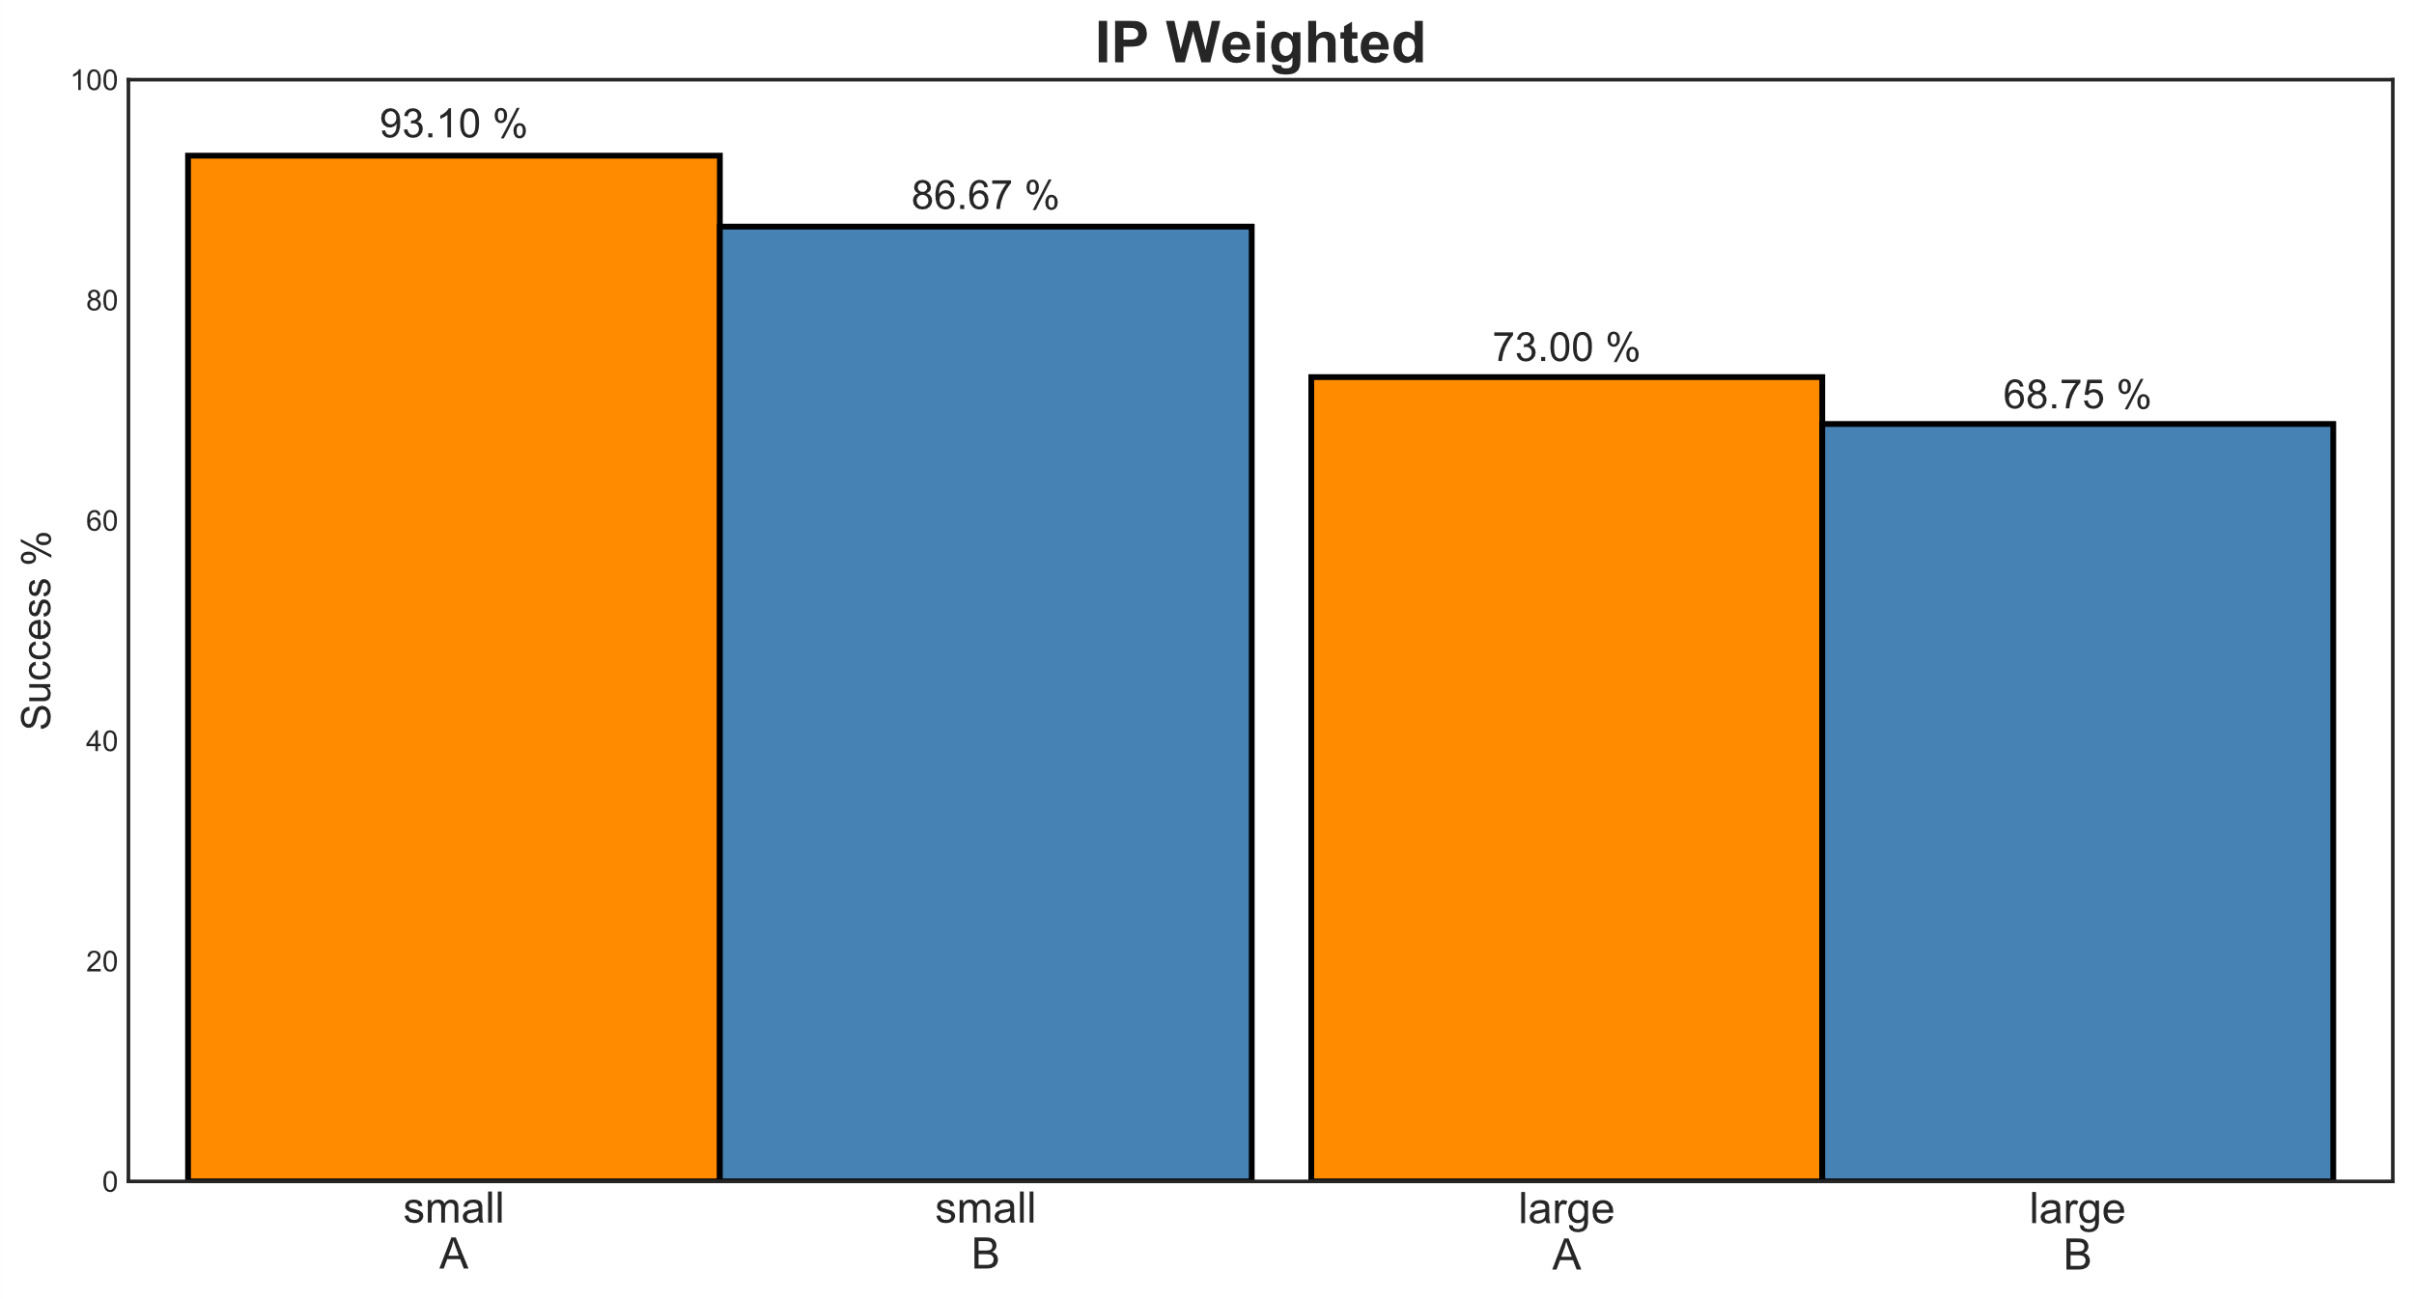

Slide 16
Equal width
Equal width

Slide 17

Equal width
Equal width

Slide 18
Equal width
Equal width
Place treatments next to each other

Slide 19
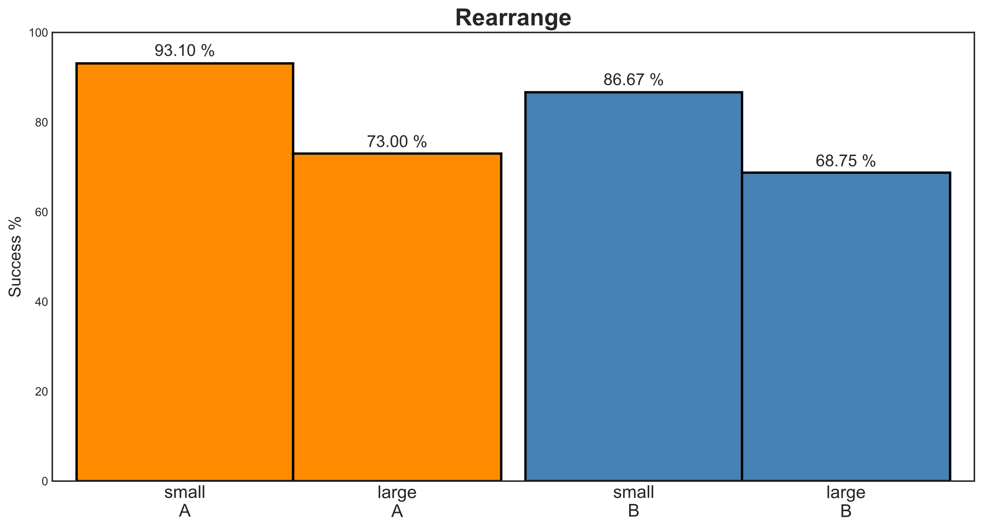

Slide 20
